Slide 1

Data Science Final Project
Team 5:
Ayushi Bhatnagar
Forum Dattani
Rutwik Ghag
Zinkal Thakker

Slide 2
Introduction
Hotels are a vital part of any travel plans one makes, whether it is for business purposes or to go on vacation with friends or family.
This is an industry that is most prone to be affected by how many people show up after making a reservation.
The dataset we have worked with focuses on the effect this factor has on a real-time hotel.
Cancellations are one of the biggest vulnerability for this industry and hence, one of our prime focuses for this project.

Slide 3
Data Insights and Actions

Slide 4
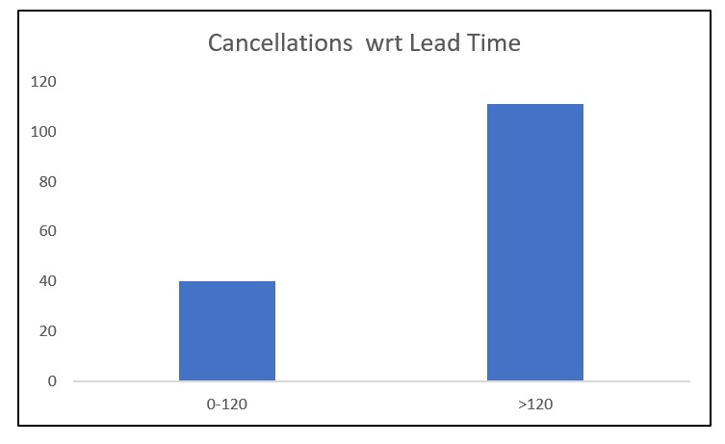
INSIGHT
ACTION
Bookings made upto 4 months before arrival have the lowest rate of cancellation.
The window for room reservation should be altered to a maximum of 4 months to ensure more reliability of the customers stay plans

Slide 5
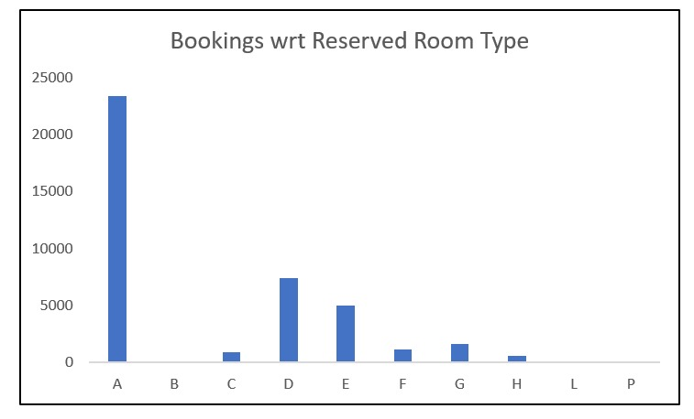
INSIGHT
ACTION
Room A has the maximum rate of booking regardless of the statistically high cancellation rate because of the high volume.
The hotel should increase availability of type A rooms and be able to assign it to the guest that have made a specific reservation.

Slide 6
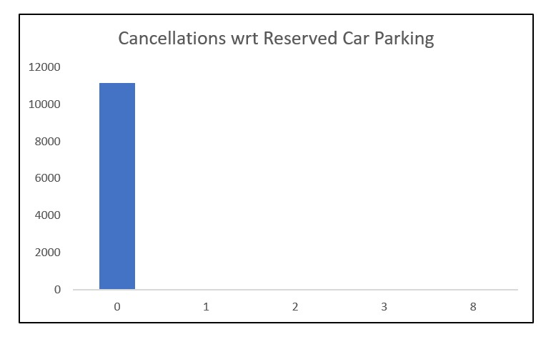
INSIGHT
ACTION
People that have made a parking reservation regardless of when the booking is done, have a 0% cancellation rate.
The hotel should promote its parking facilities and make it more accessible to guests that make end moment reservations too.

Slide 7
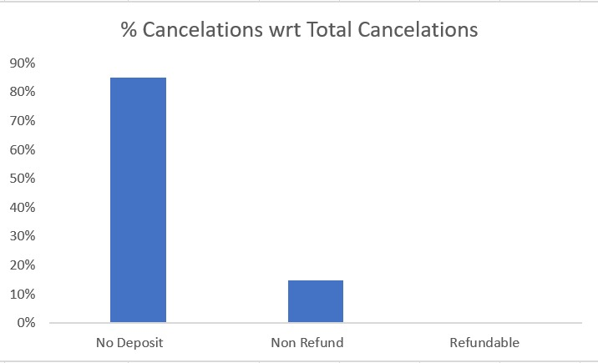
INSIGHT
ACTION
Customers that have not paid a deposit have shown the maximum number of cancellations.
The hotel should emphasize more on getting customer to pay a deposit. This should not be made a compulsion but should be encouraged. A cancellation fee can be applied instead.

Slide 8
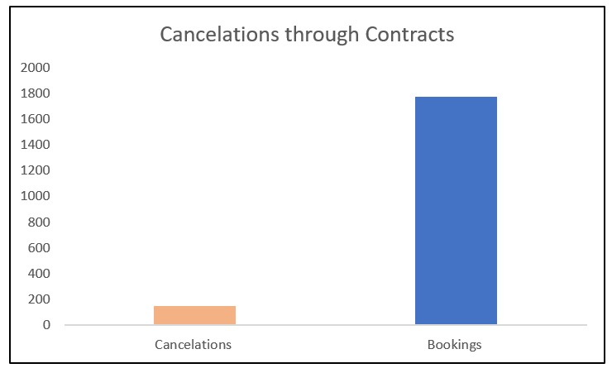
INSIGHT
ACTION
The total number of bookings made by the customer type Contract is very low in the data set with a cancellation rate of approximately 10%.
The hotel should form more corporate associations to increase the influx of contract based booking reservations since these trips have a significantly low chance of cancellation.

Slide 9
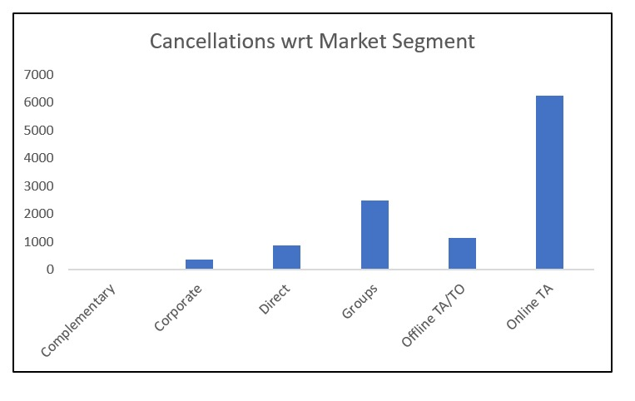
INSIGHT
ACTION
Online Travel Agent bookings have the highest cancellation rate.
The hotel should check for discrepancies in information/ images provided by Online TA to the customer about the rooms (majorly room type A) and the hotel.

Slide 10
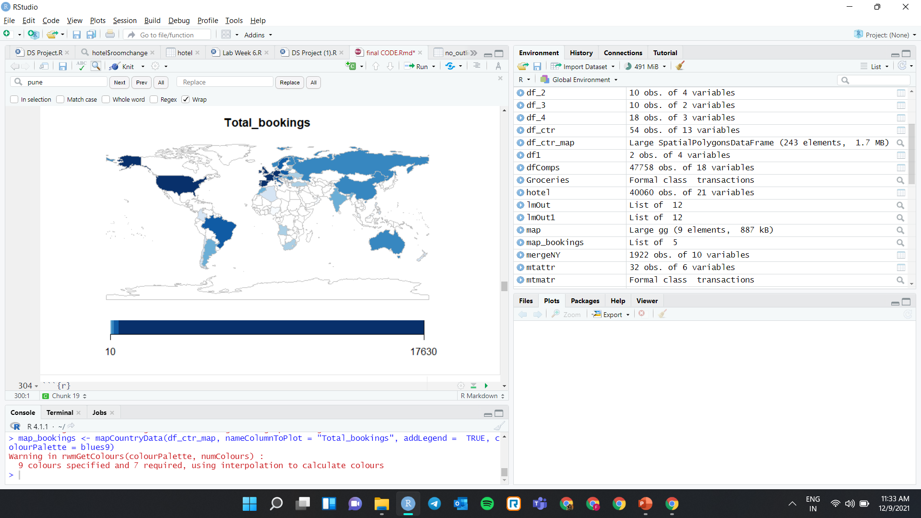
INSIGHT
ACTION
Portugal has the highest rate of booking cancellaitons.
The hotel should overbook rooms for guests that are from Portugal or keep the rooms open for end moment rebookings.

Slide 11
THANK YOU

